Slide 1



YOUTH ORGANIZE
A guide on making Facilitation
" lit"
Laid Out
inclusive
Trauma Informed

Slide 2

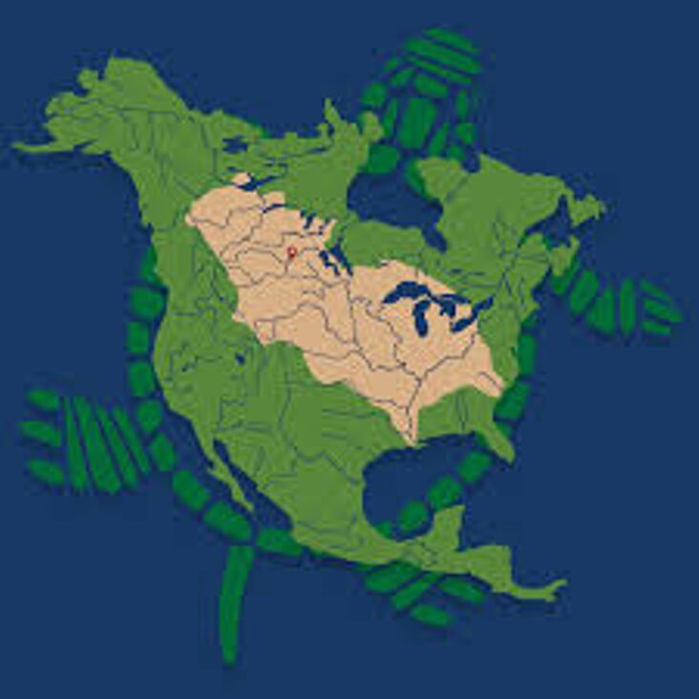

LAND ACKNOWLEDGEMENT

Slide 3
  What is facilitation?
  Foundation and Structure of Facilitation
  Inclusive/ Anti-Oppression Practices
  Trauma Informed Facilitation Practices
Outline
Presentatons are tools.

Slide 4
What is Facilitation

Slide 5
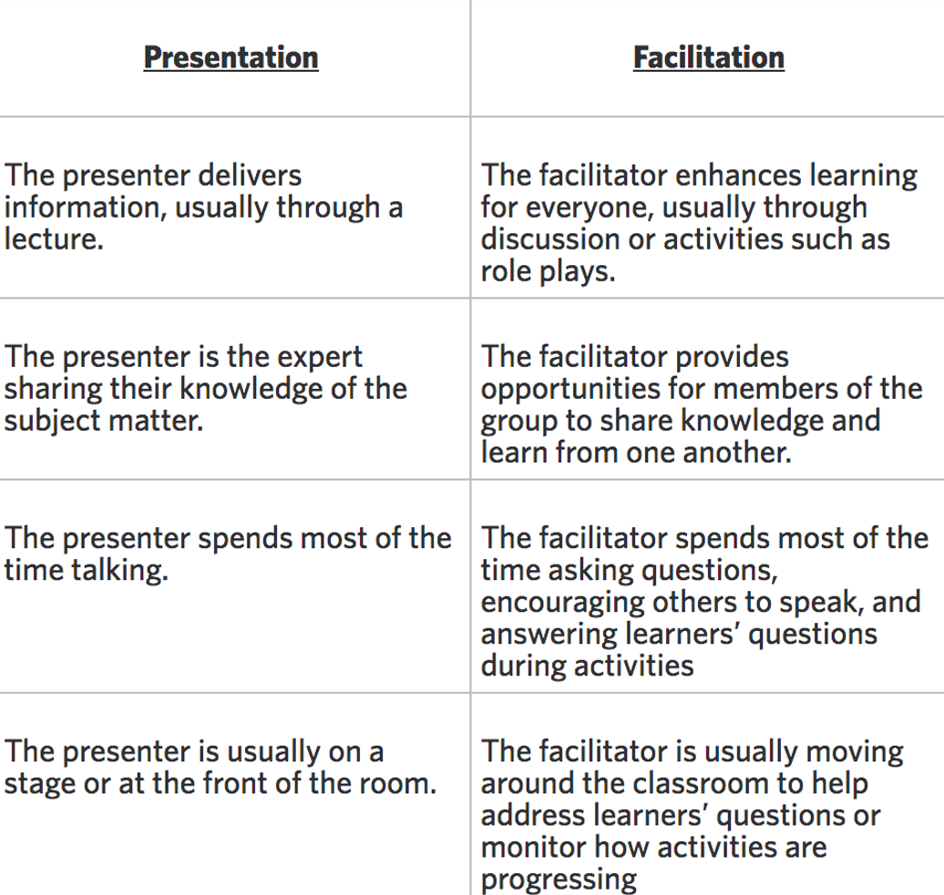
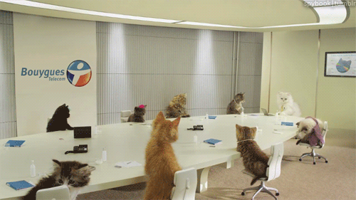

Slide 6


Fruits of Labour
The Results & Feedback
Lay-out
Support/Structure
The How!
The Foundation
Who-What-When-Where

Slide 7


The
Foundation
WHAT ARE THE GOALS OF THE SESSION?
Formal or informal
WHERE AND WHEN ARE YOU HOSTING?
Accessibility | LGBTQ Friendly Space| Food
WHO IS THE SESSION FOR?
Youth from the age of 12-17 who are .........

Slide 8


Support
and
Structure

Slide 9
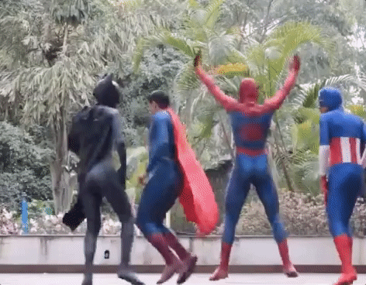
Facilitation Style
Art-Based
Movement
Technology

Slide 10
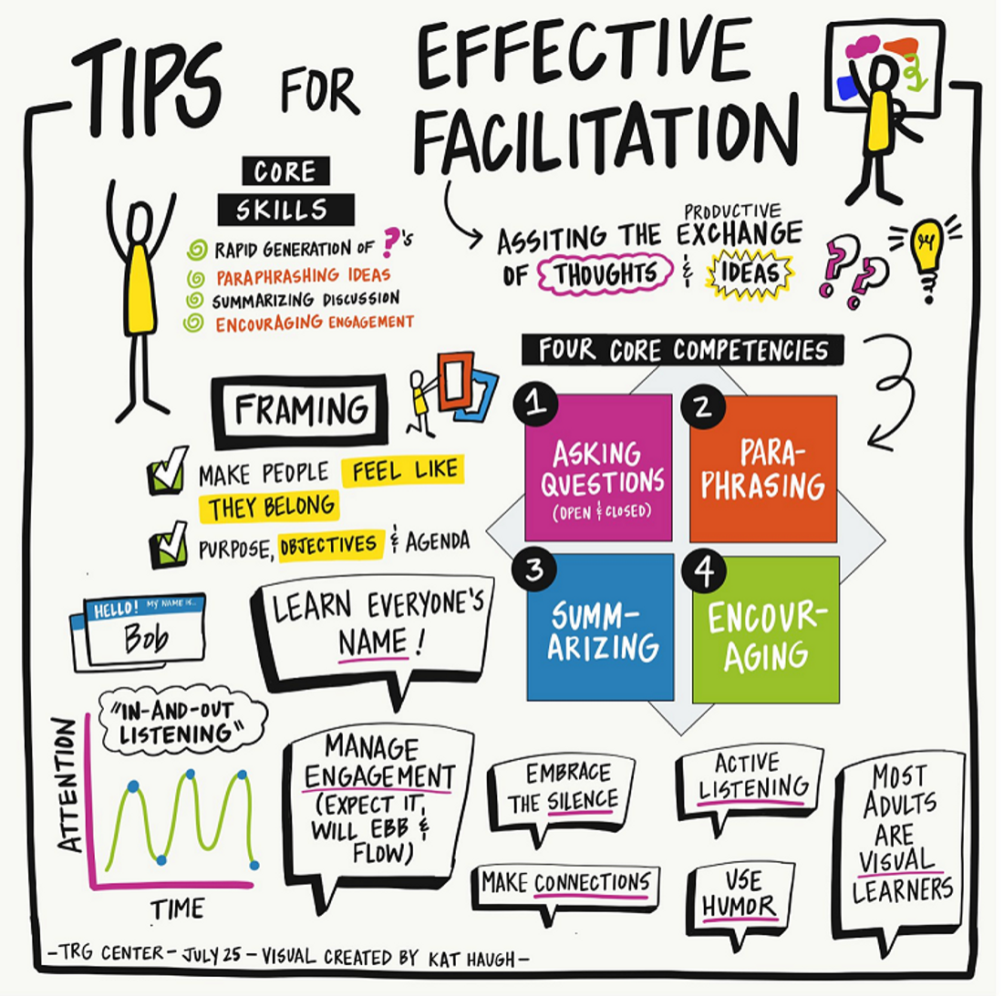

Slide 11
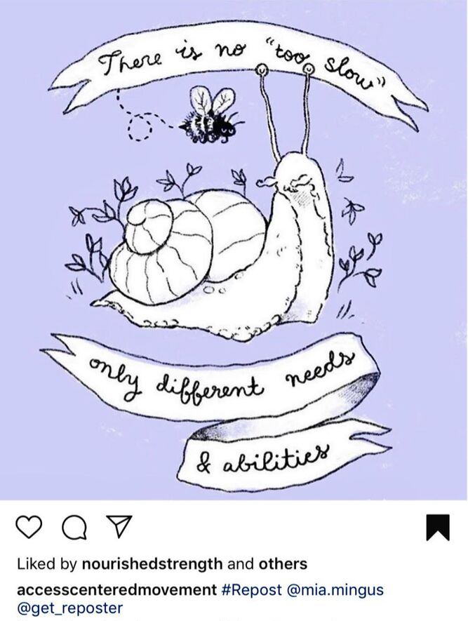
Radical Inclusion

Slide 12

What does an inclusive space
look or feel like for you?

Slide 13
Power and Privilege

Slide 14
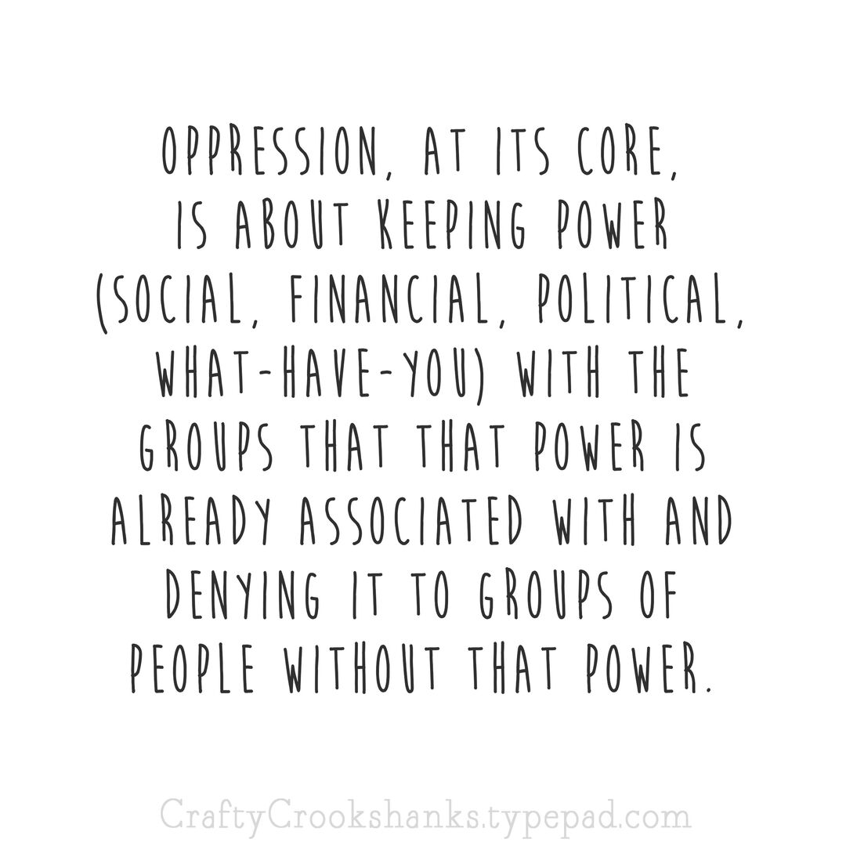
Power and Privilege

Slide 15
LAND ACKNOWLEDGEMENT

Slide 16
How can you act in solidairty with indegenious communities locally?
How can we center those voices?

Slide 17
AGENDA
COMMUNITY AGREEMENT OR
GROUND RULES
MANAGING CONFLICT
Holding Space

Slide 18
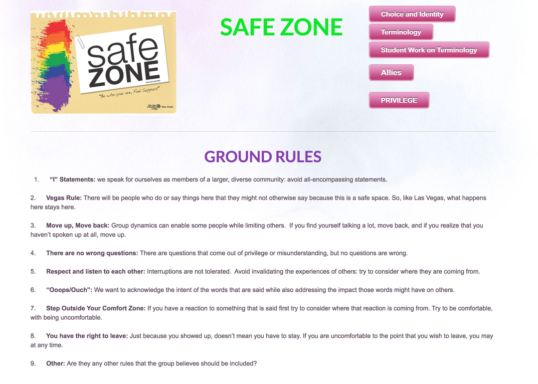
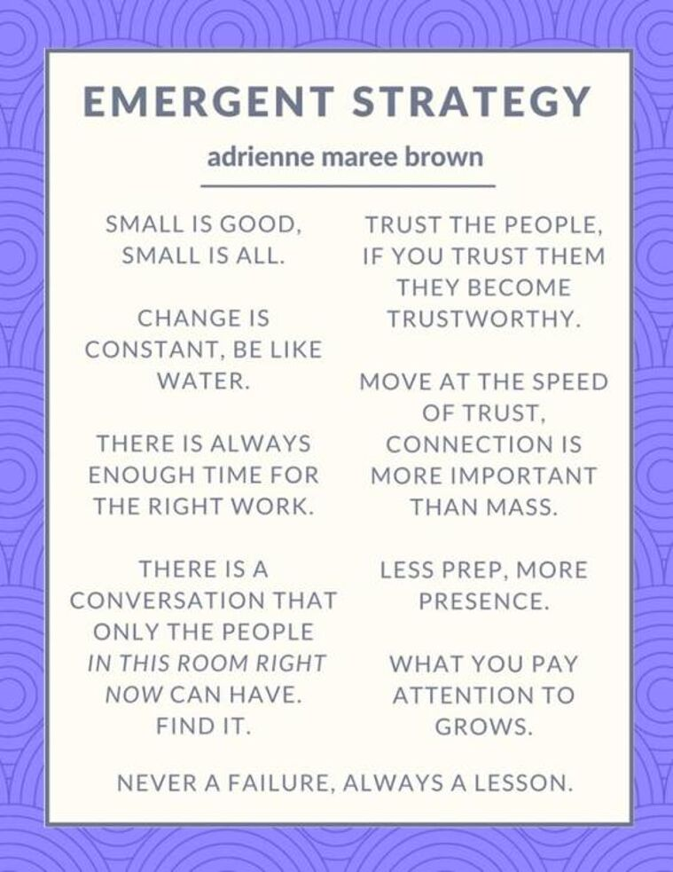
Going on the wild side

Slide 19
Lets Create Ground Rules

Slide 20
Conflict is natural Aspect of group dynamics

Slide 21
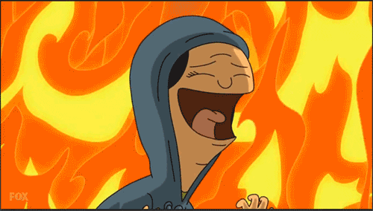



Slide 22
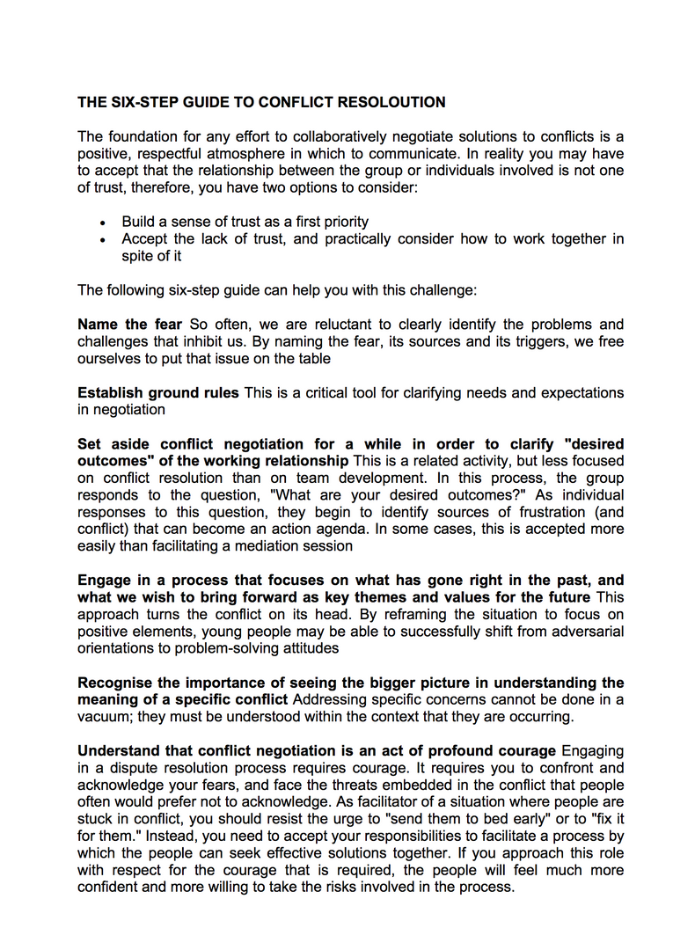

‘"PiPo- Peering in- Peering out"
2006’

Slide 23
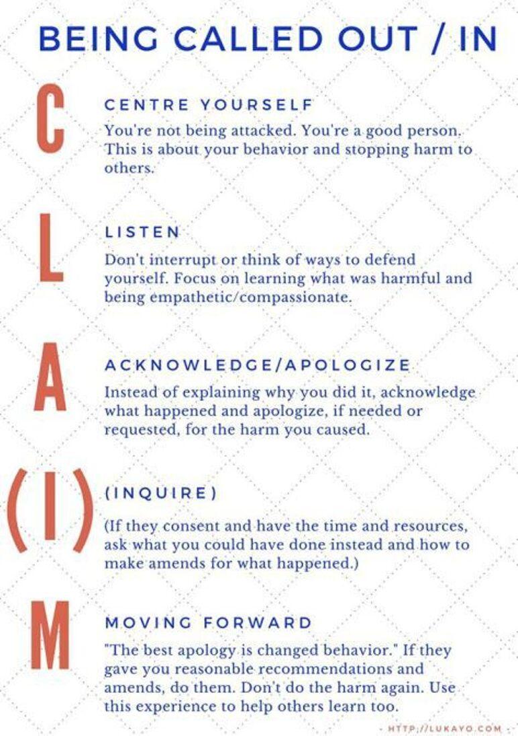

Slide 24
Fruits of Labour
FEEDBACK FORMS
DEBRIEF WITH FACILITATORS

Slide 25
Trauma Informed Practices that center consent!

Slide 26
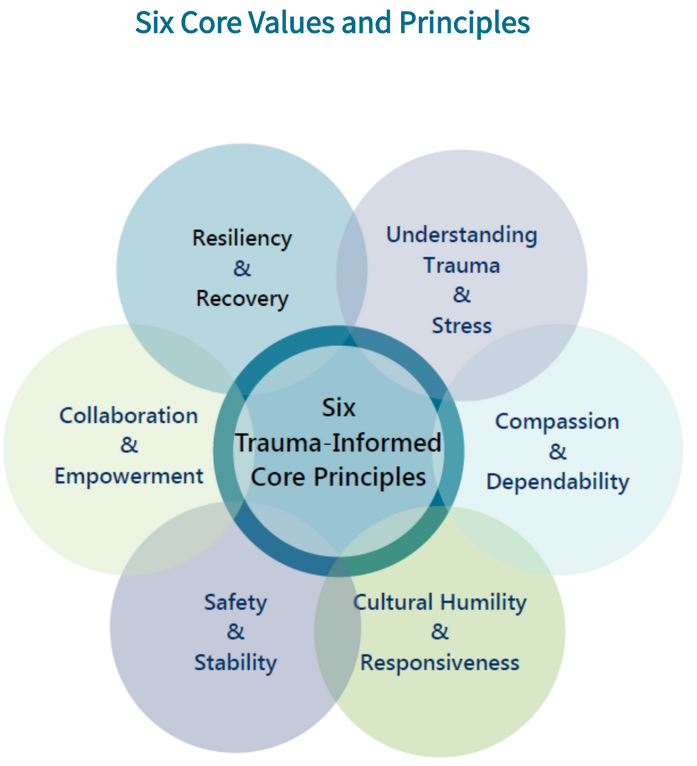

Slide 27
Resources for participants

Slide 28
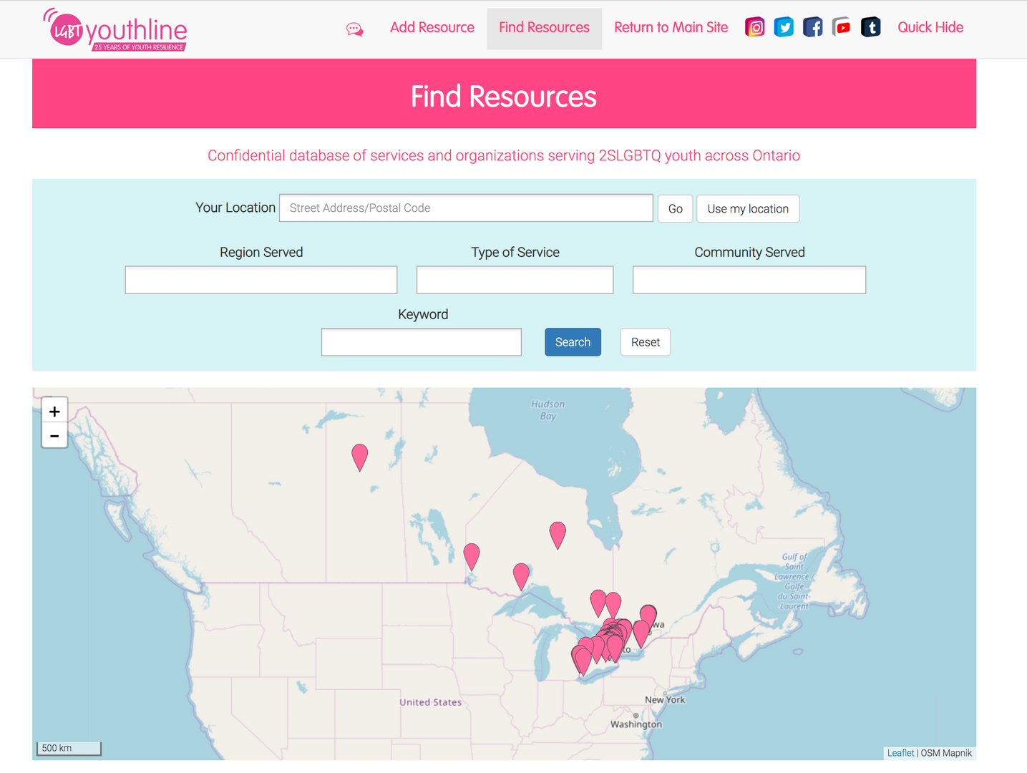
Resources for participants

Slide 29
Questions?

Slide 30
Thank You!
'TIL NEXT TIME!

